Slide 1
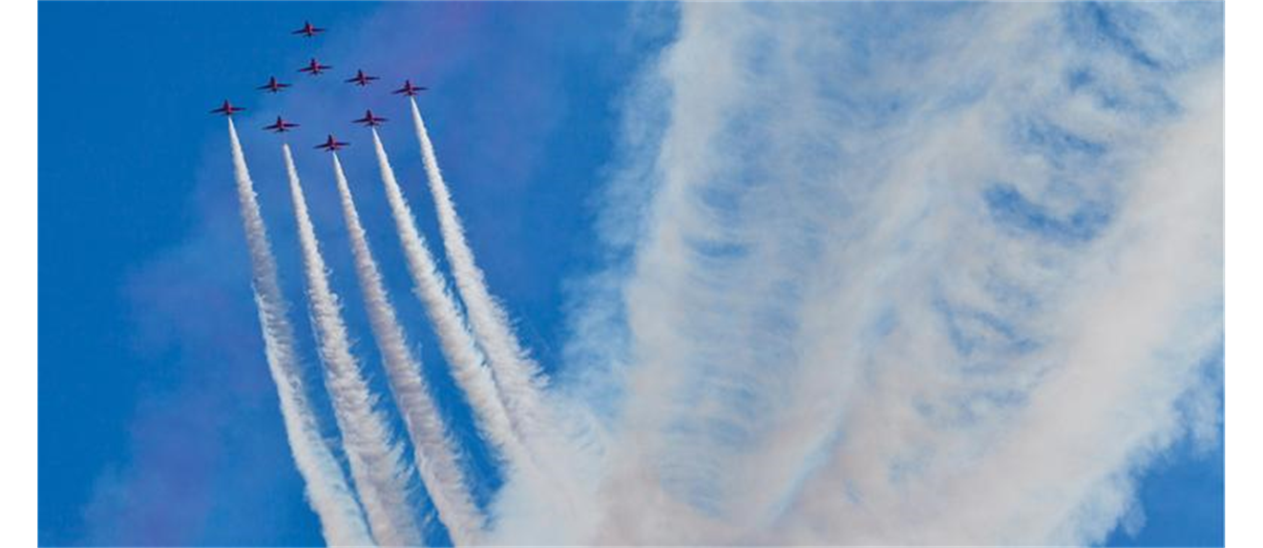


MOTION IN TWO AND THREE DIMENSIONS: BASIC DEFINITIONS

Slide 2
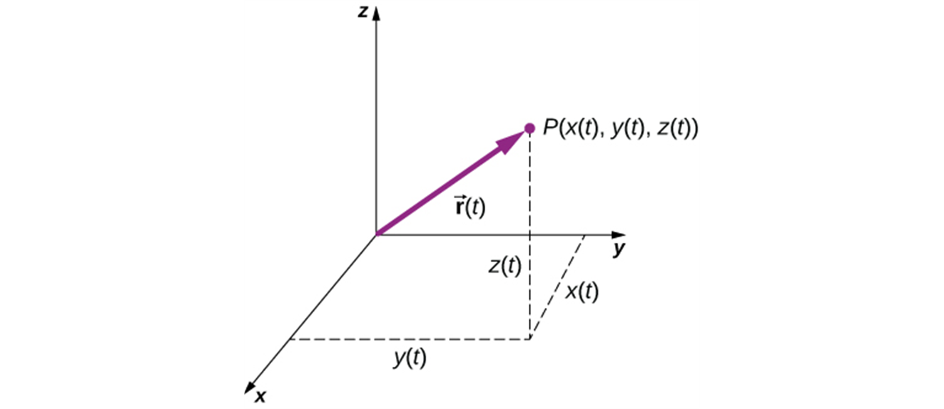
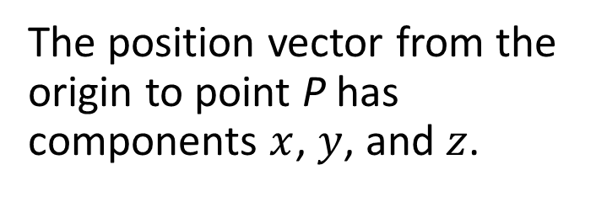
Position Vector
The position vector from the origin to point P has components $x$, $y$, and $z$.
A three-dimensional coordinate system with a particle at position P(x(t), y(t), z(t)).

Slide 3
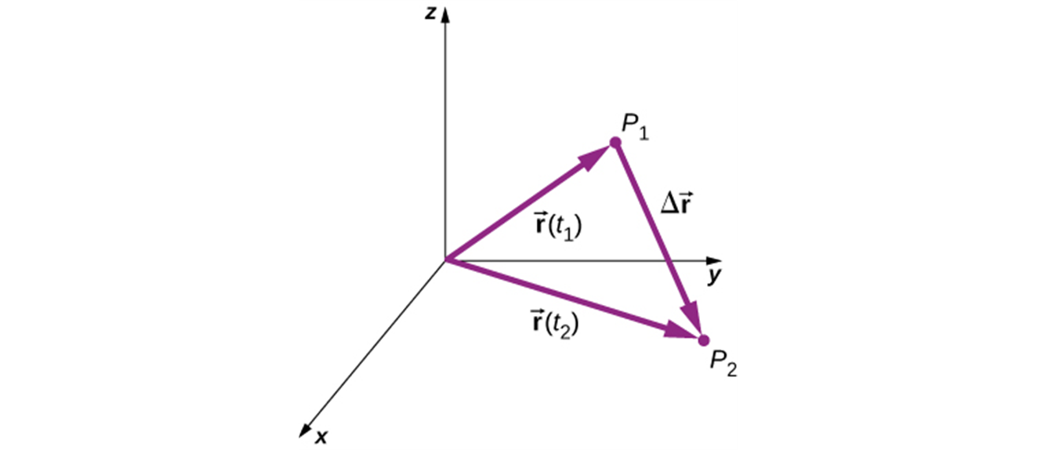
Displacement
The displacement $∆\vec{r}= \vec{r}(t_{2}$) $− \vec{r}(t_{1}\text{)}$ is the vector from P₁ to P₂.

Slide 4
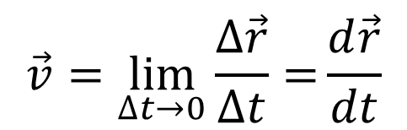
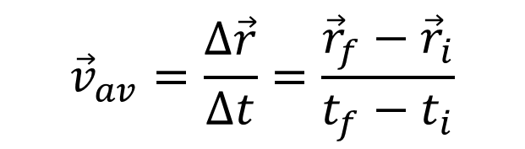
Velocity
We define the average velocity as the displacement divided by the time interval:
$${\vec{v}}_{av}=\frac{∆\vec{r}}{∆t}=\frac{{\vec{r}}_{f}−{\vec{r}}_{i}}{t_{f}−t_{i}}$$
Instantaneous velocity (“velocity”) is the instantaneous rate of change of position with time:
$$\vec{v}=\lim_{∆t→0}{\frac{∆\vec{r}}{∆t}=}\frac{d\vec{r}}{dt}$$

Slide 5
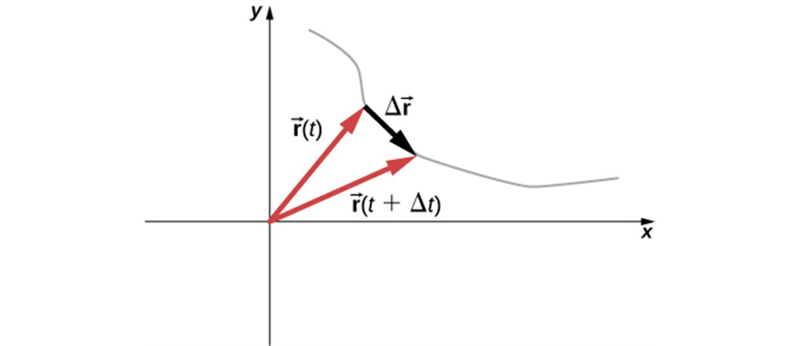
Average Velocity: Important Details
The average velocity between two points is the displacement divided by the time interval between the two points, and it has the same direction as the displacement.

Slide 6
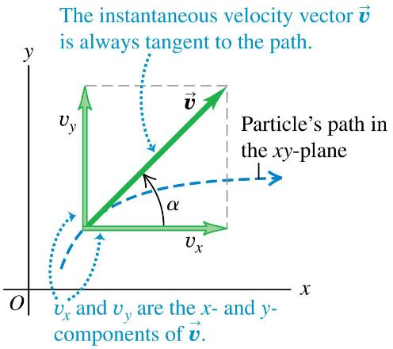

Instantaneous Velocity: Important Details
The instantaneous velocity is the instantaneous rate of change of position vector with respect to time.
The components of the instantaneous velocity are
$$v_{x}=\frac{dx}{dt}, v_{y}=\frac{dy}{dt}, and{ v}_{z}=\frac{dz}{dt}.$$
The instantaneous velocity of a particle is always tangent to its path.

Slide 7
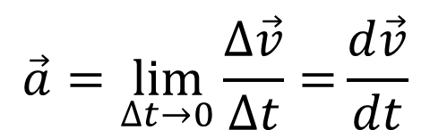
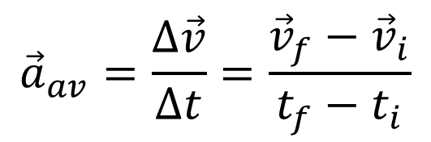
Acceleration
We define the average acceleration as the change in velocity divided by the time interval:
$${\vec{a}}_{av}=\frac{∆\vec{v}}{∆t}=\frac{{\vec{v}}_{f}−{\vec{v}}_{i}}{t_{f}−t_{i}}$$
  Instantaneous acceleration (“acceleration”) is the instantaneous rate of change of velocity with time:
$$\vec{a}=\lim_{∆t→0}{\frac{∆\vec{v}}{∆t}=}\frac{d\vec{v}}{dt}$$

Slide 8
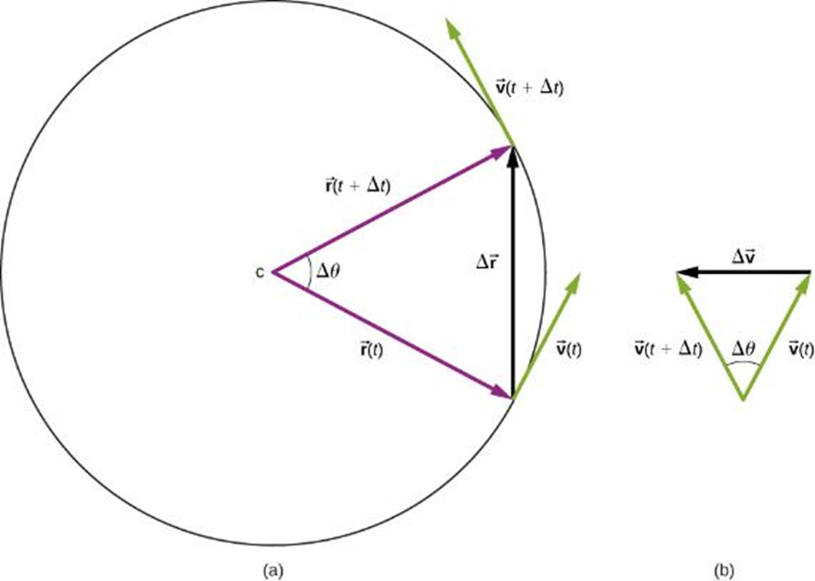
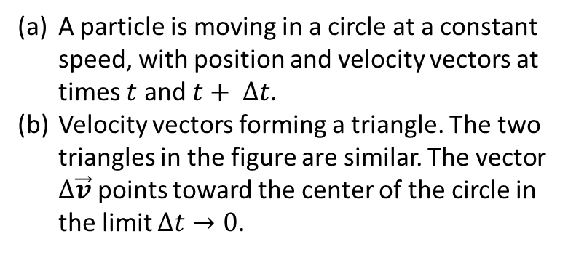
Average Acceleration: Important Details
The change in velocity between two points is determined by vector subtraction.
A particle is moving in a circle at a constant speed, with position and velocity vectors at times $t$ and $t+ ∆t$.
Velocity vectors forming a triangle. The two triangles in the figure are similar. The vector $∆\vec{v}$ points toward the center of the circle in the limit $∆t→0$.

Slide 9
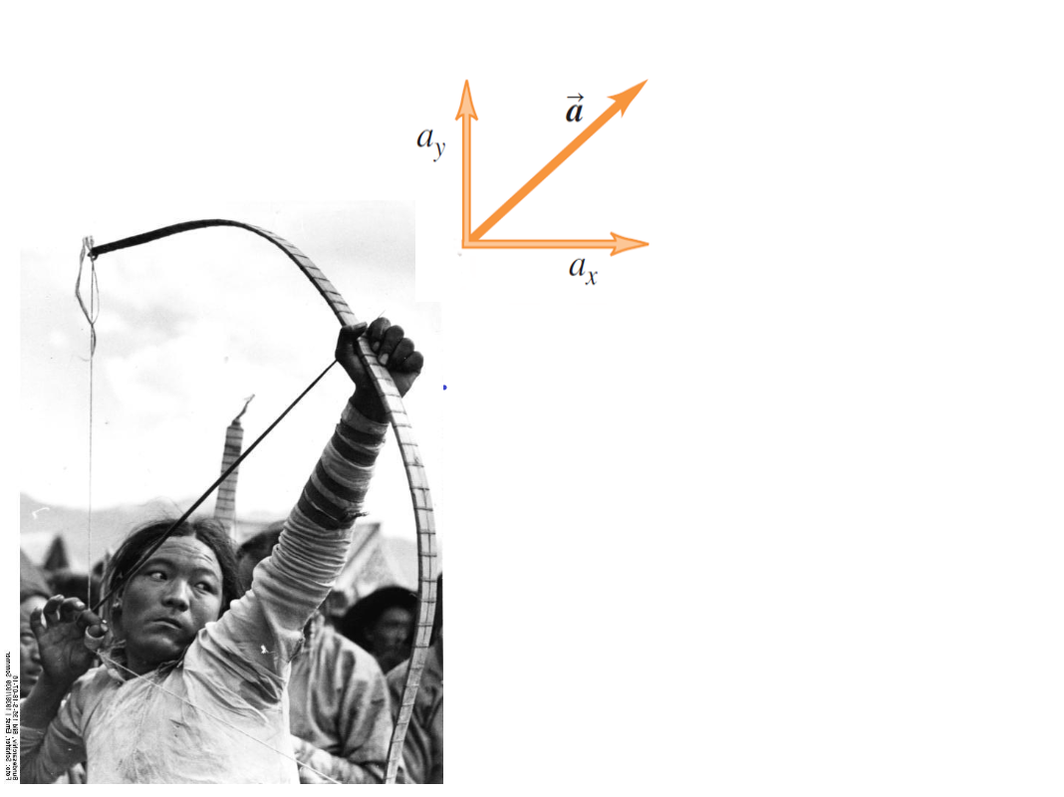
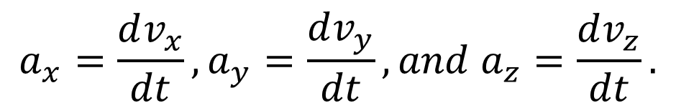
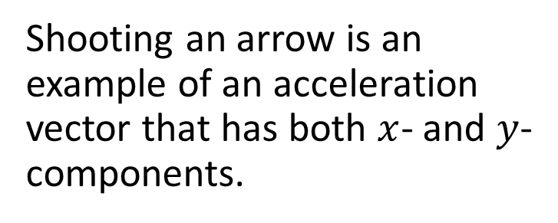
Components of Acceleration
$$a_{x}=\frac{dv_{x}}{dt}, a_{y}=\frac{dv_{y}}{dt}, and{ a}_{z}=\frac{dv_{z}}{dt}.$$
Shooting an arrow is an example of an acceleration vector that has both $x$- and $y$-components.

